Slide 1
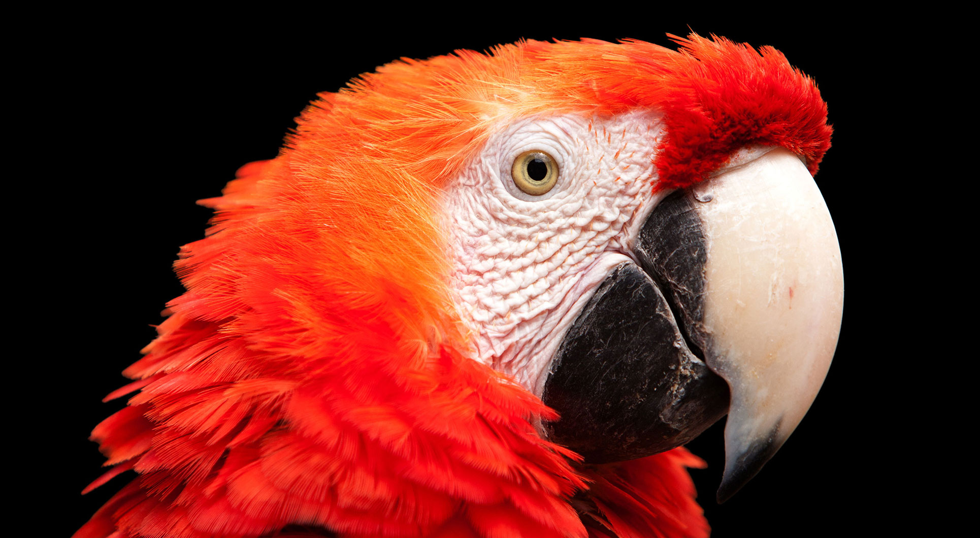
Link prediction in Graph
Advanced AI for Data Analytics
AA4 - Ghassen Abdedayem

Slide 2
Shuffling the Graph edges
Model even more robust to overfitting
But takes a bit much more epochs to train

Slide 3
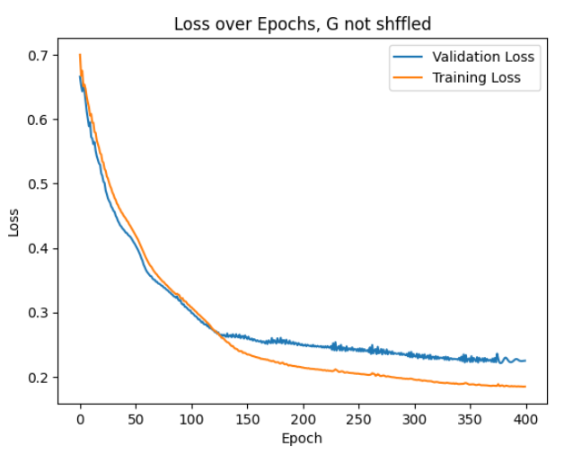
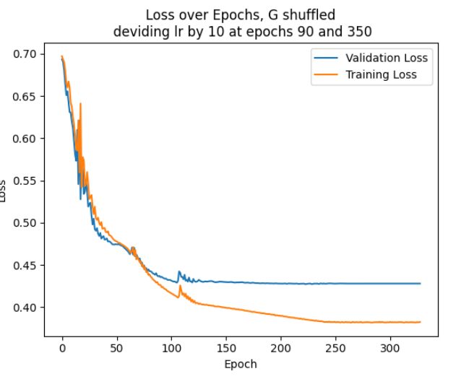

Slide 4
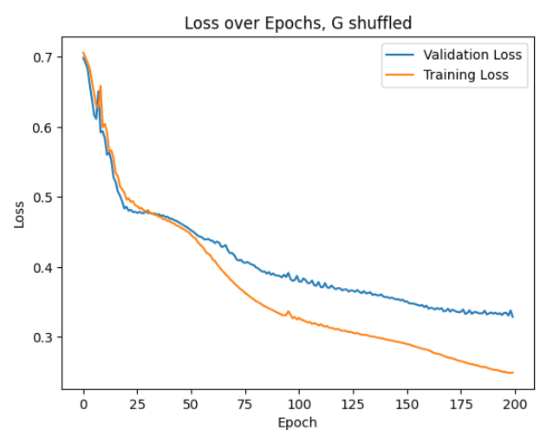
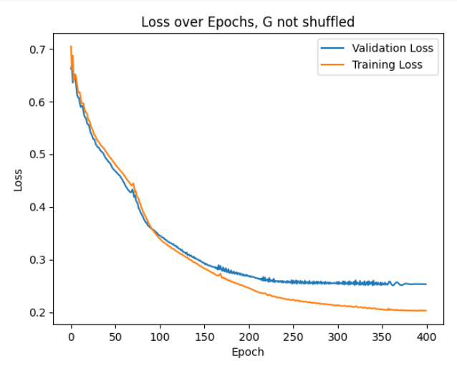
Sparse authors

Slide 5
Normalize adj

